Slide 1
Data Mining
Data Solution Institute
K.P.I. Shenesh Perera
IDM

Slide 2
What is Data mining?
Data mining could be defined as “The process of obtaining hidden predictive information”.
This presentation will introduce you to data mining, its scope, purpose and how it works.

Slide 3
Knowledge Discovery in Databases
Data mining is basically one of the steps in the process of knowledge discovery in a database (KDD). Knowledge discovery process employs 5 main steps:
Selection
Pre-processing
Transformation
Data Mining
Evaluation

Slide 4
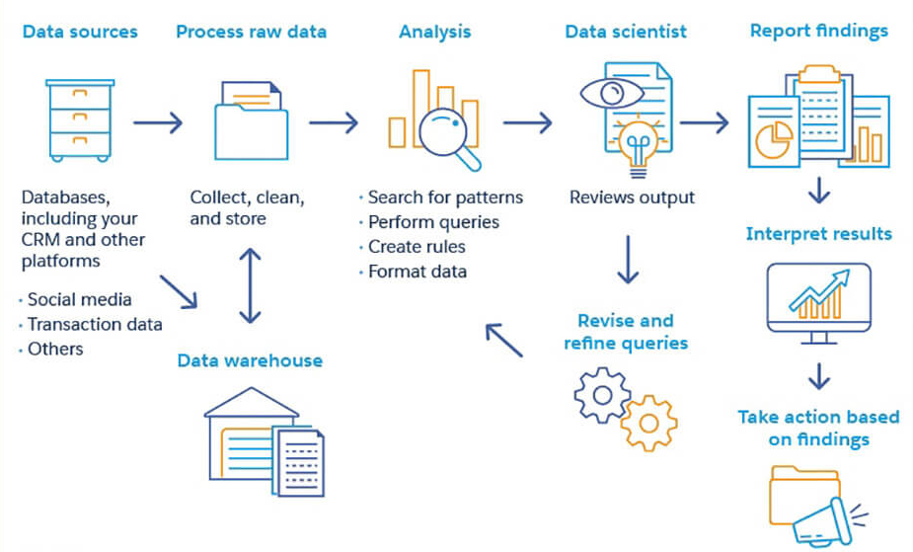
Data Mining process illustration
Figure 1.1 , slideshare.com

Slide 5
Selection Phase
Selection is the phase where we identify the data.
Several techniques and methods are used to skim through the available data set and give particular data some form of identification from large databases at operational level

Slide 6
Pre-processing Phase
Pre-processing is the phase where we cleanse and organize the data.
Data cleaning methods are activated against the identified data to remove duplications, irrelevant and data that has no particular identity

Slide 7
Transformation phase
Transformation phase is required for preparation of data.
In this phase computational logic and linguistics are used to give data a proper structure in such a way data mining can be performed.

Slide 8
Data mining
Now that all the data has been cleansed and prepared, classification, association, decision tree etc. are performed on the data to gather information from the data
When sufficient information is gathered, it becomes knowledge

Slide 9
Evaluation
Lastly we analyze information which is the evaluation phase to test the results of the data mining.
Once data has already reached this phase, it can now be provided to the management level of a business to make decisions.

Slide 10
History of Data Mining
It initially started with Thomas Bayes’ theorem in the 1700s of identifying patterns in data then further on backed by techniques such as regression analysis in 1800s.
1805 Adrien-Marie Legendre and Carl Friedrich Gauss apply regression to determine the orbits of bodies about the Sun

Slide 11
1936 This is the dawn of computer age which makes possible the collection and processing of large amounts of data.
1943 Warren McCulloch and Walter Pitts were the first to create a conceptual model of a neural network. They describe the idea of a neuron in a network. Each of these neurons can do 3 things: receive inputs, process inputs and generate output.

Slide 12
1965 Lawrence J. Fogel forms a new company called Decision Science, Inc. for applications of evolutionary programming.
1970s With sophisticated database management systems, it’s possible to store and query terabytes and petabytes of data. However, extracting sophisticated insights from these data warehouses of multidimensional models is very limited.

Slide 13
1975 John Henry Holland wrote Adaptation in Natural and Artificial Systems, the ground-breaking book on genetic algorithms.
1980s HNC trademarks the phrase “database mining.” The trademark was meant to protect a product called Database Mining Workstation.
1989 The term “Knowledge Discovery in Databases” (KDD) is coined by Gregory Piatetsky-Shapiro.

Slide 14
1990s The term “data mining” appeared in the database community.
1992 Bernhard E. Boser, Isabelle M. Guyon and Vladimir N. Vapnik suggested an improvement on the original support vector machine which allows for the creation of nonlinear classifiers.
1993 Gregory Piatetsky-Shapiro starts the newsletter Knowledge Discovery Nuggets.

Slide 15
Data mining techniques & algorithms
Data mining techniques are classified into two categories:
Supervised Learning
Unsupervised Learning

Slide 16
Supervised learning
In supervised learning, a model is built prior to the analysis.
We then apply the algorithm to the data in order to estimate the parameters of the model.
Classification, Decision Tree, Association Rule Mining etc. are examples of supervised learning.

Slide 17
Unsupervised learning
In unsupervised learning, we do not create a model or hypothesis prior to the analysis.
We just apply the algorithm directly to the dataset and observe the results.
The same algorithms mentioned previously can be used here as well.

Slide 18
Theory | Pros | Cons
Naïve Bayesian | It is easy to understand. It is not sensitive to unknown features. It handles streaming of data pretty moderately. It can handle real and unreal values. | It assumes independence of features even when there is insufficient data to back it up. Therefore provides less accuracy.
CART | It does not require preselection of variables. It easily handles and identifies anomalies quickly. | It is pretty unstable during the implementation of a decision tree. It allows only splitting by one parameter.
Figure 1.2, Shenesh Perera

Slide 19
Text Mining
Text mining is the elaborative process of analyzing and searching through large amounts of text data that have no apparent structure.
It is more often known as text analytics.

Slide 20
Please proceed to watch this video alongside your course material to get a better understanding of text mining;
https://youtu.be/xxqrIZyKKuk
From: elsevier.com

Slide 21
At a glance, text mining includes categorizing, clustering and tagging text; summarizing data sets and extracting information about things such as word occurrence rates and relationships between particular data entities.
The most commonly used text mining algorithms are those used for classification.

Slide 22
Text mining is basically a task that when considering a pair of entities that occur in a particular sentence, the objective is to categorize the relations based on some predefined list.
Barely any other algorithms are used in text mining, when classification is used the company has to decide depending on a set of rules that should be applied so as to obtain the result they wish to obtain.

Slide 23
Graph Mining
The task of graph mining is to extract patters (sub-graphs) of interest from graphs, that describe the underlying data and could be used further, e.g., for classification or clustering.

Slide 24
Graph mining has a vast number of applications, e.g. biological networks or web data.
Even though sub-graph isomorphism is a NP-complete problem, many graph mining tools for frequent sub-graph mining exist that can be applied to large databases

Slide 25
Graph mining unlike the previously mentioned types of mining is not extensively nor broadly used in the industry, mainly due to the lack of expertise.
As such information regarding graph mining is very low.
It is mostly used in medicinal fields and chemistry simulations.

Slide 26
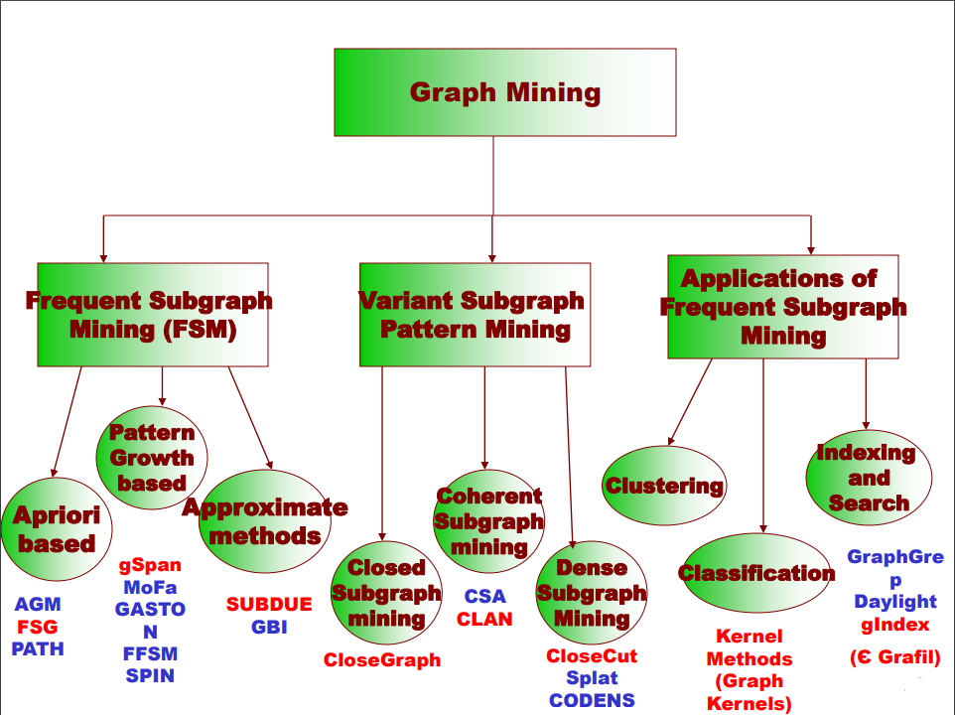
Figure 1.3, helinski.fu

